Slide 1
Power BI
Microsoft Power BI is a tool that converts data from various data sources into interactive BI reports and dashboards. With Power BI, you can quickly connect your data, wrap it, visualize it as needed, and share it securely across sites.

Slide 2
Power BI Components
Power Query: The Power Query is an important component that is used for searching, accessing, and transforming public and internal data sources.
Power Pivot: Data modeling for in-memory analytics in Power BI is taken care of by Power Pivot.
Power View: You can visualize, analyze, and display data in Power BI with the help of Power View.
Power Map: The Power Map creates interactive geographical data visualizations.
Power BI Service: By using Power BI Service, you can share data views and workbooks and refresh from on-premises and cloud-based data sources.
Power BI Q&A: The Power BI Q&A allows you to ask questions and get prompt answers using a natural language query.
Data Management Gateway: The Data Management Gateway provides regular data refreshers, views data feeds, and exposes tables.
Data Catalog: By using Data Catalog, the user can discover along with reusing queries using the Data Catalog. Also, this kind of functionality can be facilitated by using Metadata.

Slide 3
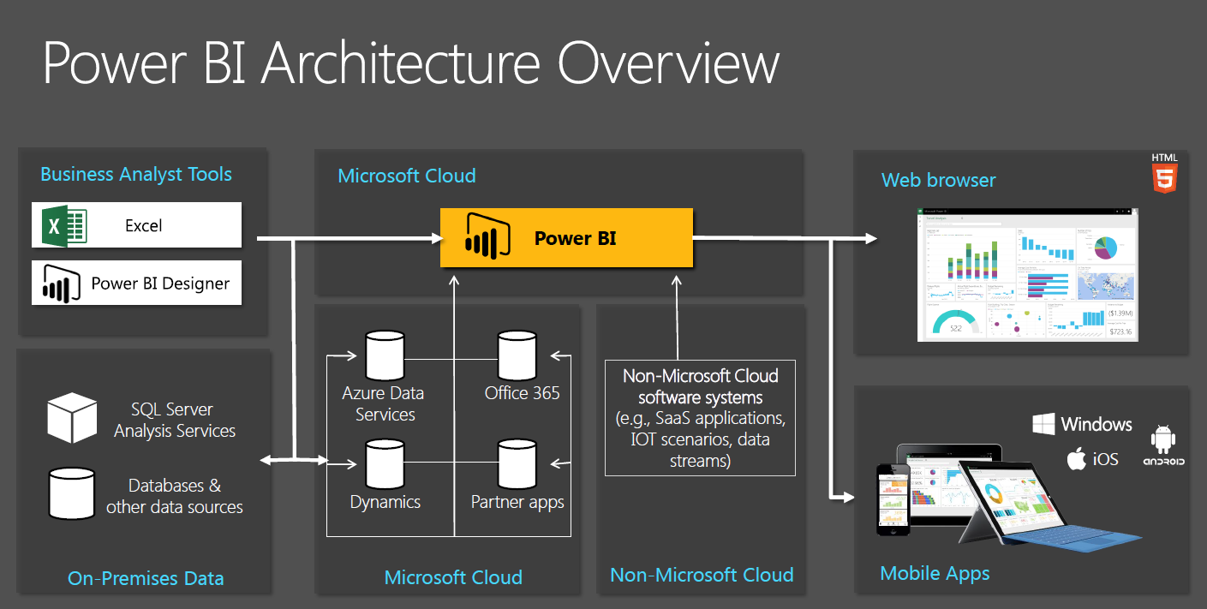
Power BI Architecture

Slide 4
Why do we need Power BI?
Power BI provides interactive visualization of data with self-service business intelligence capabilities. With Power BI, end users can create their own interactive business intelligence reports and dashboards without depending on IT personnel or database administrators. Most organizations use Power BI as their business analytics solution.

Slide 5
Power BI Tools
1- Power BI Service
2- Power BI Desktop
3- Power BI Report Server
4- Power BI Gateway
5- Power BI Mobile
6- Power BI Apps

Slide 6
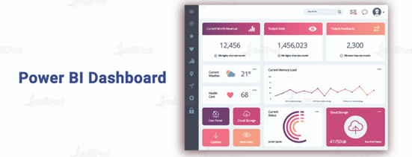
Power BI Dashboards & it’s Advantages
The Power BI Dashboard is basically a page consisting of visualizations to represent a story or business insight. It is limited to only one page and can be viewed and shared on mobile devices as well. The visualizations that are seen on the dashboard are obtained from reports that are gathered from datasets.
The interactive visualizations available on the Power BI Dashboard are considered one of the best ways to monitor business. All the metrics can be viewed at a glance. The Power BI Dashboard is also known as Canvas, as it consists of a single page. This is going to make it easier for you to have a clear view of the metrics in spite of multiple reports from different datasets.

Slide 7
Power BI Reports & DAX
Power BI allows you to create reports with multiple perspectives from one dataset, later stored in the Power BI Report Server. These reports are known as Power BI reports. You can create and edit the reports on the Power BI desktop and publish them on the web portal. Post-publication, the readers can view the reports in a web browser or the Power BI Mobile on a mobile device. The reports in Power BI can have one or more visual pages.
Data Analysis Expressions (DAX) in Power BI is a formula expression language used to create calculated fields and apply them to datasets. DAX offers a collection of operators, functions, and constants that can be used to create formulated columns and rows for better understanding. DAX has different data types, such as numeric, decimals, currency, integers, binary objects, and strings.

Slide 8
Difference between Measure & Calculated Column
Calculated columns are nothing but the extension of a table using the DAX formulas to add new columns while creating data models on the Power BI Desktop. Also, the content to be added in the new columns is defined by a DAX expression.
Calculated columns are computed based on data that has already been loaded into your data model. When you write a calculated column formula, it is automatically applied to the whole table and evaluated individually for each row. The values in calculated columns are evaluated when you first define them and when you refresh your dataset.
Measures are a different way of defining calculations in DAX models. Basically, they are used when you are not operating on a row-by-row basis but are doing so on aggregated values that are defined by the current context.
Measures are computed at query time. A measure is stored in the model as source code, but it is computed only when it is used in the report.
Another important difference between measures and calculated columns is that measures are evaluated in the filter context of the visual in which they are applied.
The filter context is defined by the filters applied in the report such as row selection, column selection, report filters and slicers applied. Measures are only evaluated at the level of granularity they are plotted at. As calculated columns are computed when you first define them/ when you refresh your dataset, they do not have access to the filter context. Calculated columns are calculated outside of the filter context and do not depend on user interaction in the report.

Slide 9
Difference between the Power BI Desktop & Power BI Service
The Power BI Desktop is the complete report authoring tool for report designers. It is downloaded as a free application and installed on a local computer. The desktop allows you to connect to different types of data sources and then transform it in a data model. The final part of the report creation process is to add visuals based on the data model.
The Power BI Service is the cloud-based service where users view and interact with the reports. Report designers use the Desktop application to publish the Power BI reports to the Service. Users in the Service can edit the reports and create visuals based on the existing data model and also share and collaborate with co-workers.
There are a small number of areas where the Desktop and Service overlap. However, most implementations use the Power BI Desktop to create the reports and then use the Service to distribute the reports with others.

Slide 10
Power BI Pricing
Power BI has 3 pricing levels:
Free
Pro
Premium
Power BI Free :
With a free plan, you can use Power BI with all its analytics features. Even on the Power BI Service, you can create your own reports and dashboards.
The free plan is meant for personal use. All sharing features are disabled except for the ability to publish dashboards on the web.
If your data is sensitive, you might not want to do that. Publishing your dashboard on the web means everyone could see your dashboard whether you gave the link to it or not.

Slide 11
Power BI Pro :
Power BI Pro, which costs $9.99 per user per month, is the next step from the free plan.
With a Pro license, you get access to Power BI’s full capability including collaboration, publishing, sharing, and ad hoc analysis.
Power BI Pro licenses individuals for the creation of content and consumption. Yes, to consume content made by others, you need to be on Power BI Pro (unless your organization is on the Power BI Premium plan and you have access to the content).
Power BI Premium :
Power BI Premium is designed for companies that want to have a dedicated capacity for their data to achieve higher performance.
Its current price stands at $4,995 per month. From that price tag alone, it’s obvious that this plan is targeted at large enterprises.

Slide 12
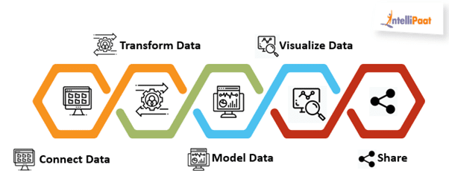
Working of Power BI
In Power BI, you should first connect your data to the tool, transform the data that you have uploaded, model the data as needed, visualize the data, and share the generated results.
Connecting Your Data
You can either use Power BI or Power BI Desktop to connect a variety of data sources, such as MySQL Server, MySQL, Oracle, etc. You can connect your data to Power BI in two ways either upload your file to Power BI or import the file into Power BI.

Slide 13
Transforming Your Data
Once your data is loaded, you can transform it as per your needs. You can do this by using the Transform menu. It has a set of operations, including reverse rows, count rows, rename, replace values and errors, pivot and unpivot columns, etc.
Modeling Your Data
For data modeling, add the data sources in Power BI’s new report option. Power BI lets you add functions, calculations, relationships, measures, etc., to your data for better visualization and analytics; this is done so that the data can be used to derive better business insights. This functionality of Power BI is referred to as Data Modeling. By using Power BI Data Modeling, you can even write a query to your files so that you can accomplish different tasks in a short span of time.
Companies Using Power BI
Microsoft
Oracle
IBM
Tableau Software
SAP
Dell
Wipro

Slide 14
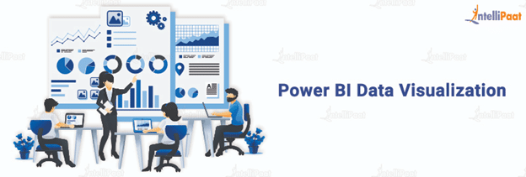
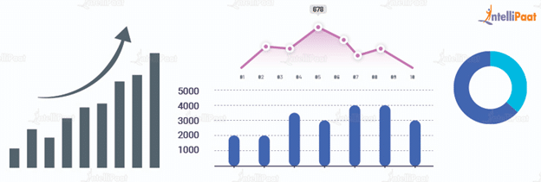
Data Visualization
In Power BI, you can create reports, dashboards, etc. based on the modeled data and depending on your organization’s requirements. Report creation can be done in many ways; you have to select a field of your choice from your CSV or data file, and then choose the tool that you want to give to your data so as to generate the desired report. You can use a variety of tools and even add a custom visual gallery.

Slide 15
Advantages of Power BI
Has a short learning curve as compared to other BI tools such as Tableau
Simple and easy-to-use interface with drag-and-drop features for data visualization
Introduces new functionalities and data analysis functions almost every month
Crowning features allow you to create customized dashboards and meet exact organizational demands
The power natural language interface lets you run database queries through voice commands
Allows the author to connect with live data sources and provides the information to the stakeholders in real-time

Slide 16
Power BI Deployement
Power BI Deployment Pipelines is a feature in the Power BI Service that allows developers to manage the development lifecycle of Power BI content. It's a cloud-based service that supports collaboration and report editing for organizations and teams.
Deployment Pipelines automate the process and reduce the risk of error. They allow creators to develop and test Power BI content before it's made available to users.
The deployment process allows users to clone content from one stage to another, usually from development to test, and from test to production.

Slide 17
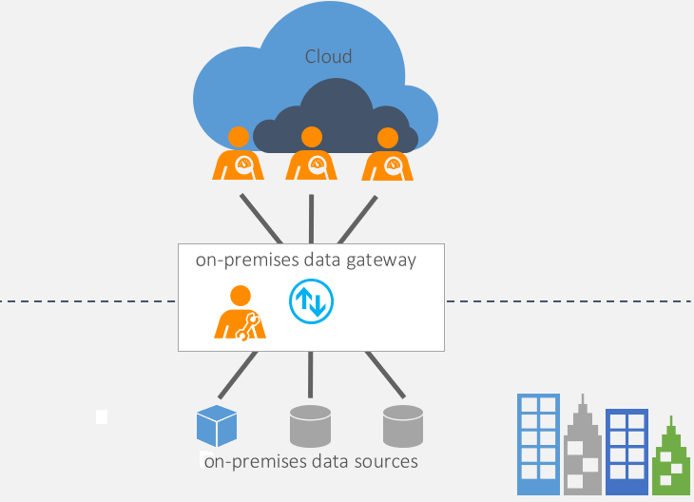
Power BI Gateway
Power BI Gateway connects Power BI cloud-based data analysis technology and the data source on-premises. Gateway is an application that can be installed on any server in the local domain. The gateway is responsible for creating the connection and passing data through.

Slide 18
What Is Power Query?
Power Query is a powerful Power BI tool that takes care of Power BI operations in locating, connecting, and loading diversified data across various sources. It also shapes and transforms the imported data so that it can be used to create visuals. It is also referred to as a self-service ETL tool in Power BI since it is self-sufficient to extract, load, and also transform data. It can be accessed in Power BI Desktop by going to the Get Data option in the Home Menu.

Slide 19
Conclusion
In this Power BI step-by-step tutorial, you learned that Power BI is a business intelligence tool through which you can make creative reports and dashboards for better decision-making. You also learned about business intelligence, its importance, how Power BI came into existence and importance, the working of Power BI, companies using Power BI, etc. You will learn about the building blocks of Power BI in the next session.

